Slide 1
<Connected experiences for consumers>
<PLSquared>
PRoDIGI 2022

Slide 2
Team info
Basic team information
Team name: PLSquared
College name: Sri Venkateswara College of Engineering
Basic information
Member college ID | Member name | Department | Year of passing | Email ID
2127210501080 | Logesh S | CSE | 2025 | 2021cs0520@svce.ac.in
2127210501110 | Prasanna V B | CSE | 2025 | 2021cs0547@svce.ac.in
2127210501113 | Praveen C | CSE | 2025 | 2021cs0053@svce.ac.in
2127210501089 | Mathivanan R | CSE | 2025 | 2021cs0228@svce.ac.in
2127210501081 | Lokesh Varathan M | CSE | 2025 | 2021cs0559@svce.ac.in

Slide 3
Our implementation of the idea
Churn analysis is used to identify potential customers drifting to competitors. Past customer purchase behaviour can be used to identify retention rate.
We have implemented churn analysis using scikit-learn. A sample data of ~5000 tuples was taken, and split for testing and training. The data splitting is done by using train_test_split function.
A Random Forest classifier is a machine learning algorithm that can be used to classify data for churn analysis. The algorithm is based on the concept of decision trees, where each tree in the "forest" makes a prediction and the final prediction is made by combining the predictions of all the trees.
Data such as days since last purchased, total order count, comparison to last years purchases are taken into consideration for performing churn.
We have managed to achieve an accuracy of 99.937% after cleaning the dataset removing redundant/invalid entries.

Slide 4
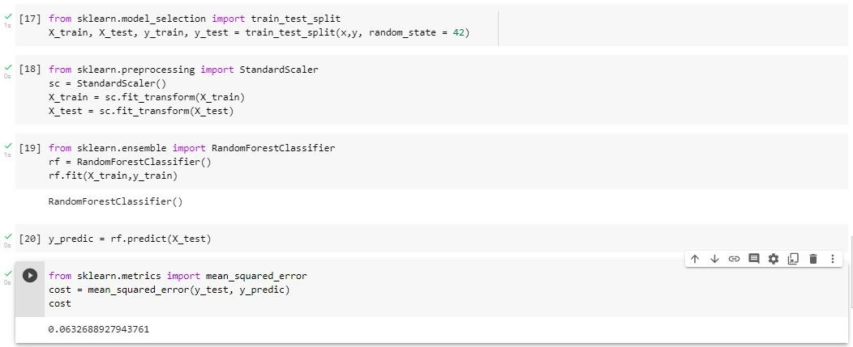
Model & Results
*The above 0.063% represents the error in disparity from actually calculated data

Slide 5
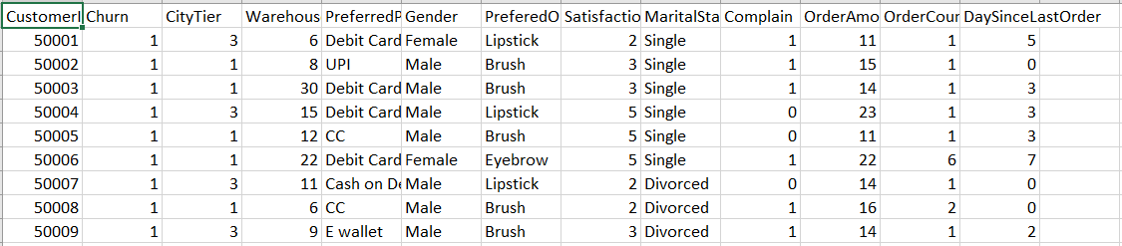
Model & Results
Churn analysis has been performed on data of similar order. The constraints taken into consideration include satisfaction score (Average ratings), number of complaints etc
The model can further be enhanced by including view-to-purchase ratio, click-through rate.

Slide 6
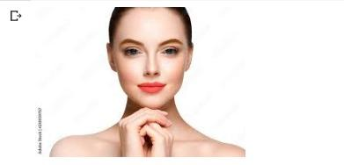
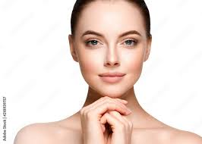
Face model recognition and enhancements using filters
Users can greatly benefit from trying out colours applied on different parts of their face/nails before purchasing. This can reduce churn to a large extent as user dissatisfaction can be mitigated from expectations they have on the products.
Colors can be applied to eyebrows, eyes (Lenses), lips, cheeks etc. The percentage of product to be applied can also be modified within the app.
Face recognition has been done using dlib and face-recognition libraries and modifications have been done using opencv2 and PIL libraries.
Original Image
Enhanced Image

Slide 7
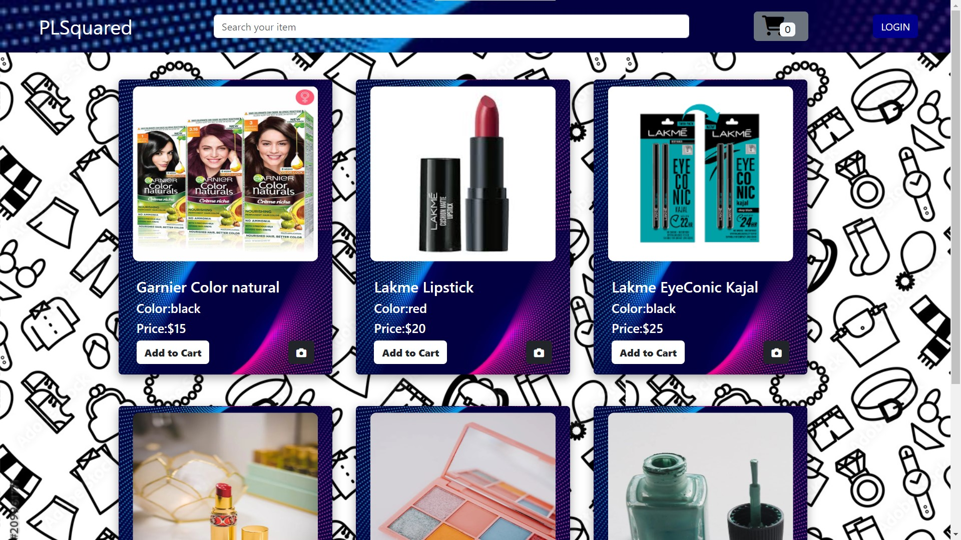
Simple Web interface for viewing and purchasing products

Slide 8
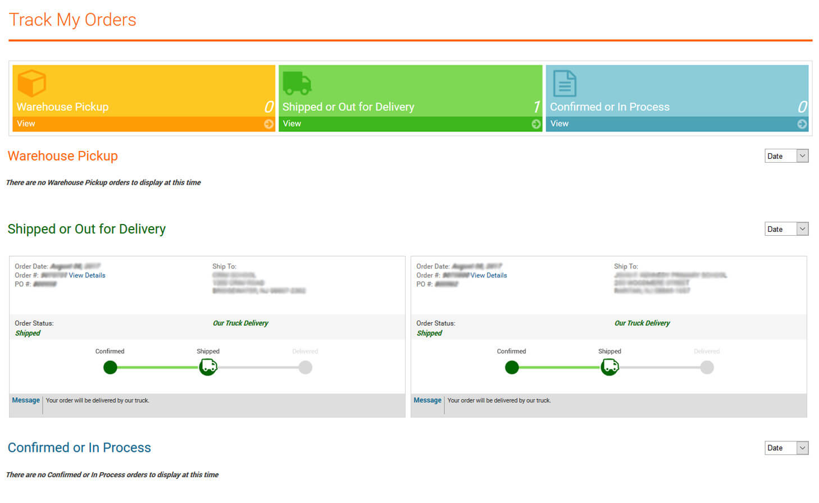
Tracking Order

Slide 9
About the Web UI and special features
Research shows a simple UI plays a vital role in decision making. Smoothness and number of steps required for a purchase can be decisive for cumulative purchase experience and user retention.
Products can be recommended based on a combination of both Collaborative Filtering and Content-Based Filtering where the system uses collaborative filtering to suggest items that are similar to what the user has previously consumed and also uses content-based filtering to recommend items that are similar to items that the user has shown interest.
A live order tracking system, alongside a promise system (Expected date of arrival), steps at which products are moved (Warehouse-transport-local storage-delivery)
The face recognition and online make up portal are integrated into each valid product and can be used to send emails, provide offers etc to the user.

Slide 10
Thank you

